Slide 1
Unit 6 - Development of Surfaces Examples
Engineering Graphics (MEC103)

Slide 2
PARALLEL LINE METHOD

Slide 3
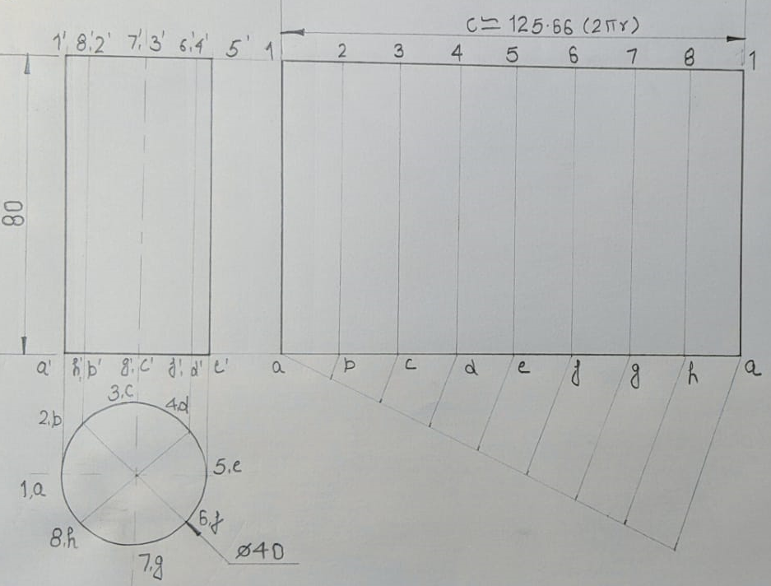
Development of Cylinder

Slide 4
Development of Truncated Cylinder

Slide 5
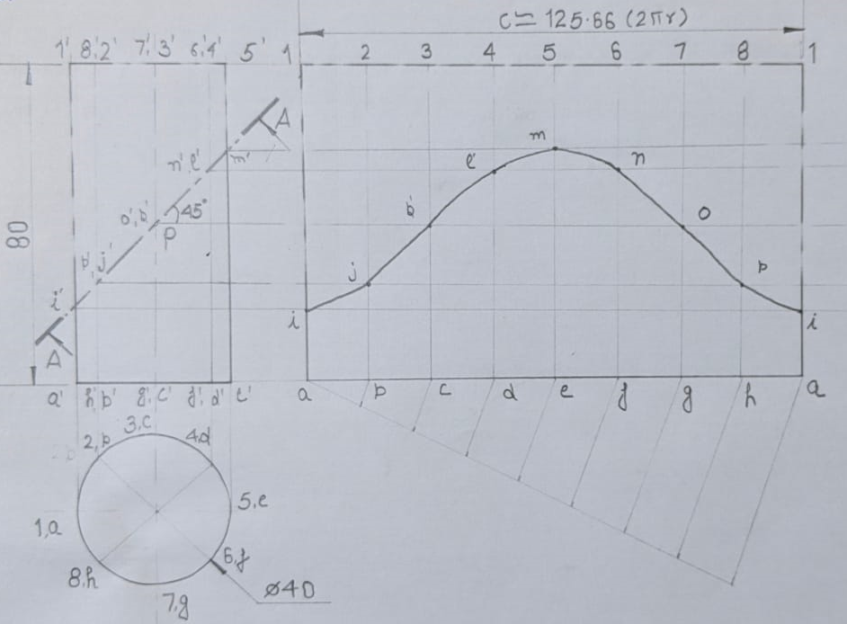
Development of Truncated Cylinder

Slide 6
Development of Triangular Prism

Slide 7
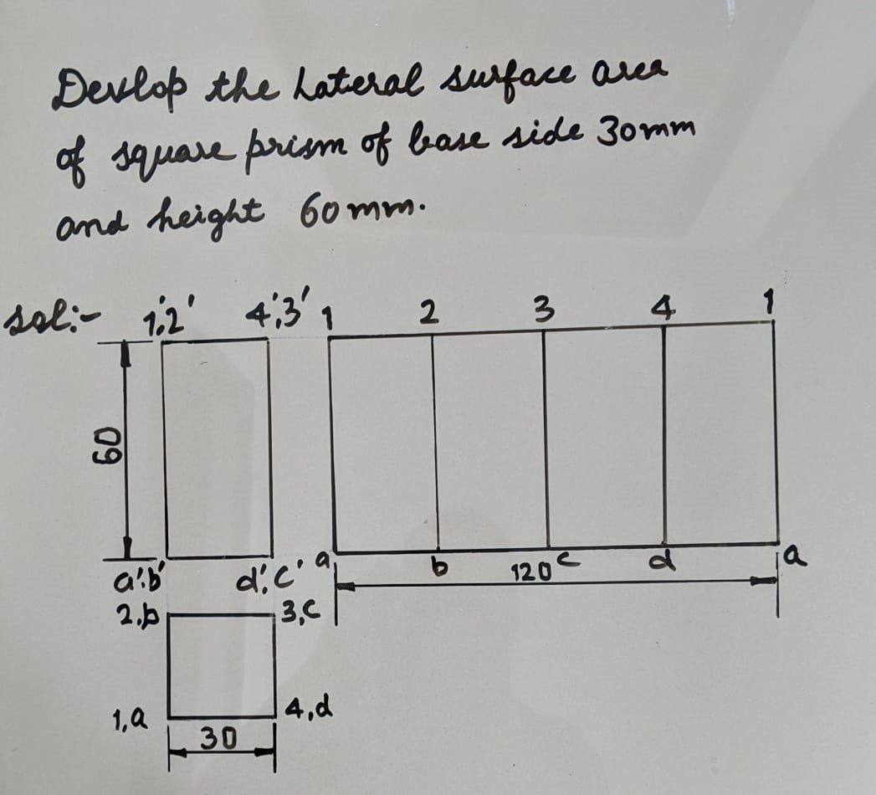
Development of Square Prism

Slide 8
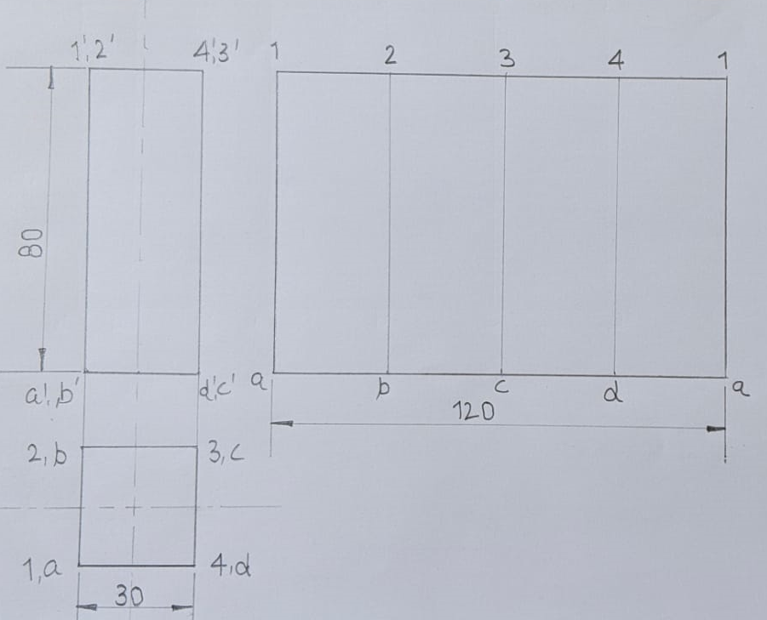
Development of Square Prism

Slide 9
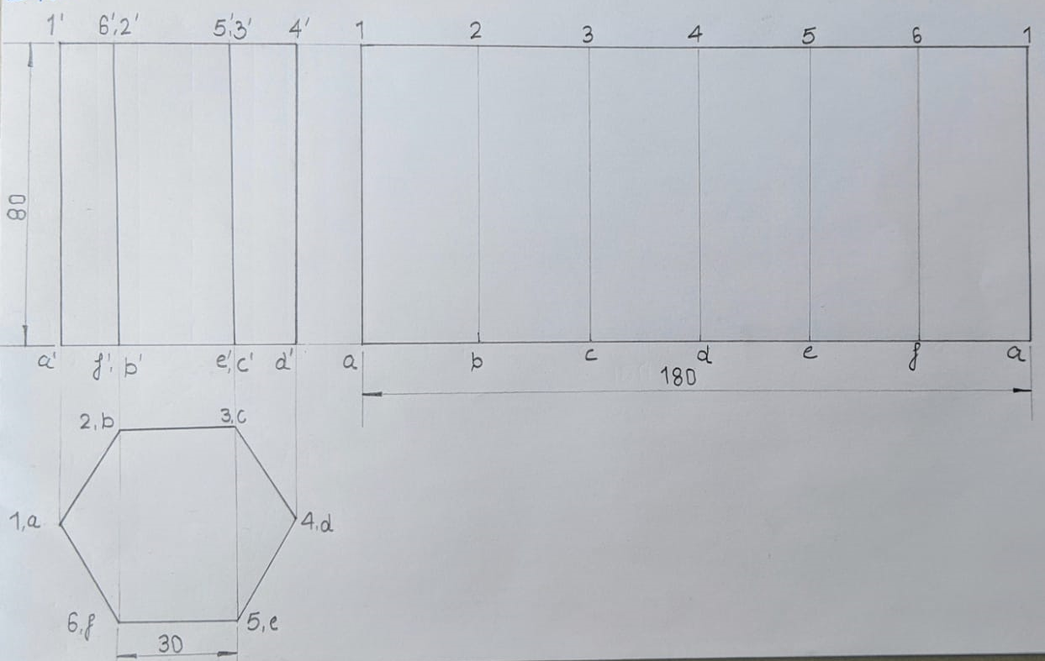
Development of Hexagonal Prism

Slide 10
Development of Truncated Triangular Prism

Slide 11
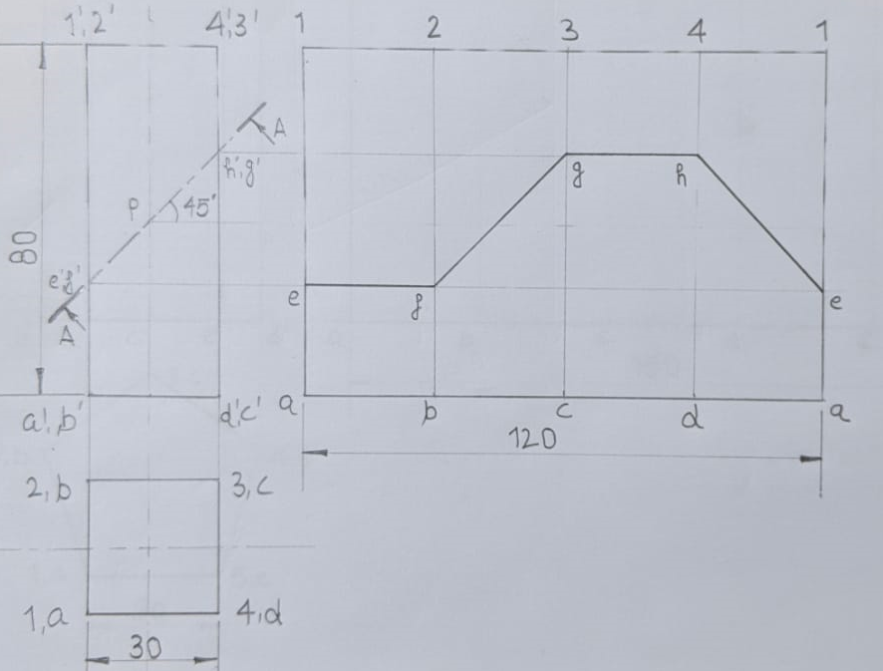
Development of Truncated Square Prism

Slide 12
Development of Truncated Pentagonal Prism

Slide 13
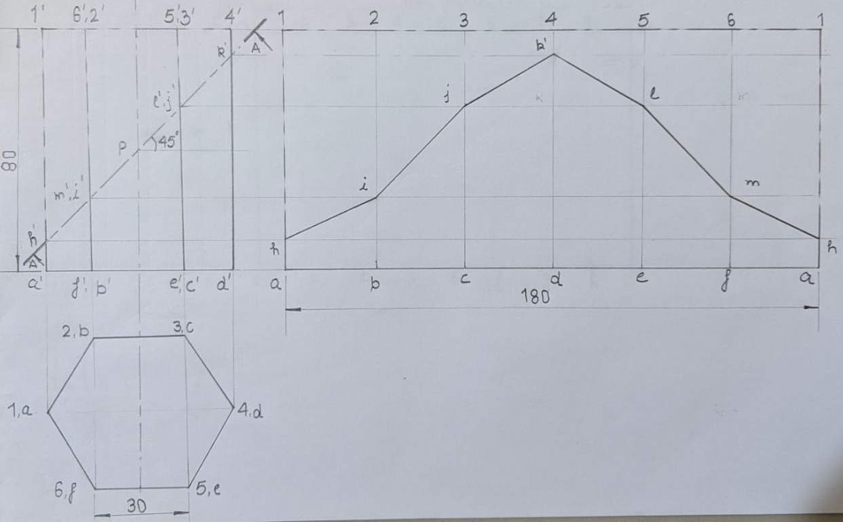
Development of Truncated Hexagonal Prism

Slide 14
RADIAL LINE METHOD

Slide 15
Development of Cone

Slide 16
Development of Truncated Cone

Slide 17
Development of Truncated Cone

Slide 18
Development of Triangular Pyramid

Slide 19
Development of Square Pyramid

Slide 20
Development of Pentagonal Pyramid

Slide 21
Development of Hexagonal Pyramid

Slide 22
Development of Truncated Triangular Pyramid

Slide 23
Development of Truncated Square Pyramid

Slide 24
Development of Truncated Pentagonal Pyramid

Slide 25
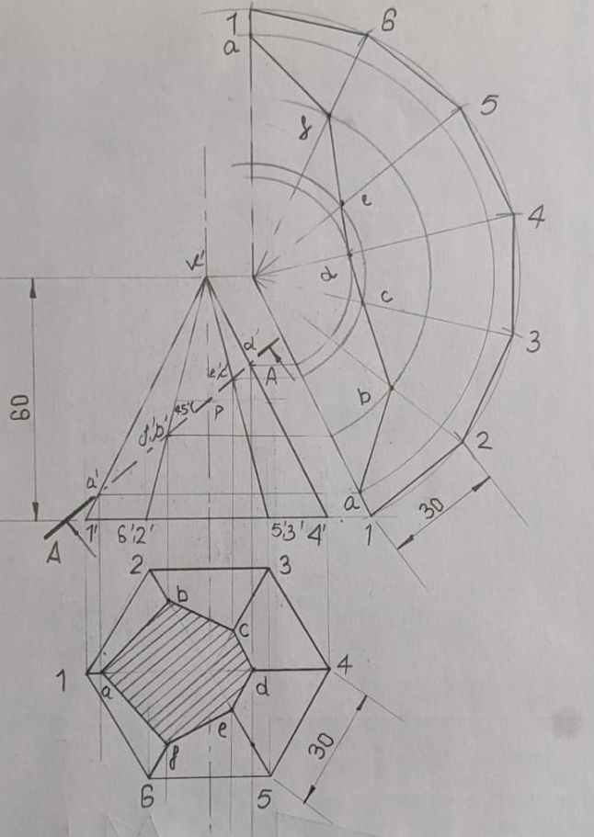
Development of Truncated Hexagonal Pyramid

Slide 26
THANKS

